Slide 2
Infrared 101

Slide 3
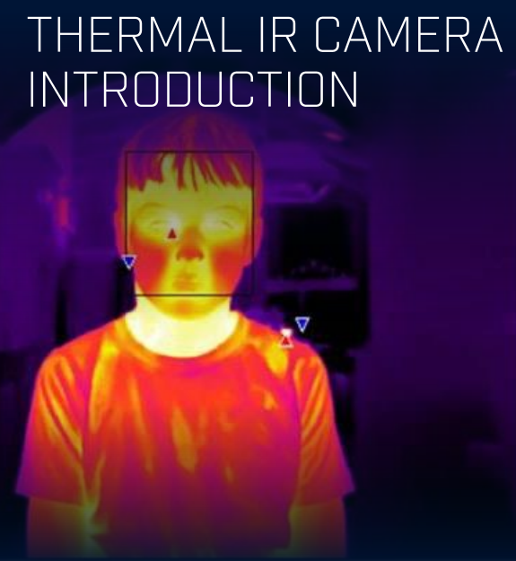
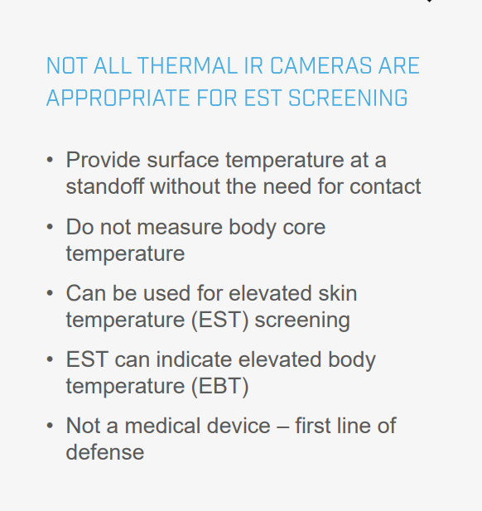

Slide 4
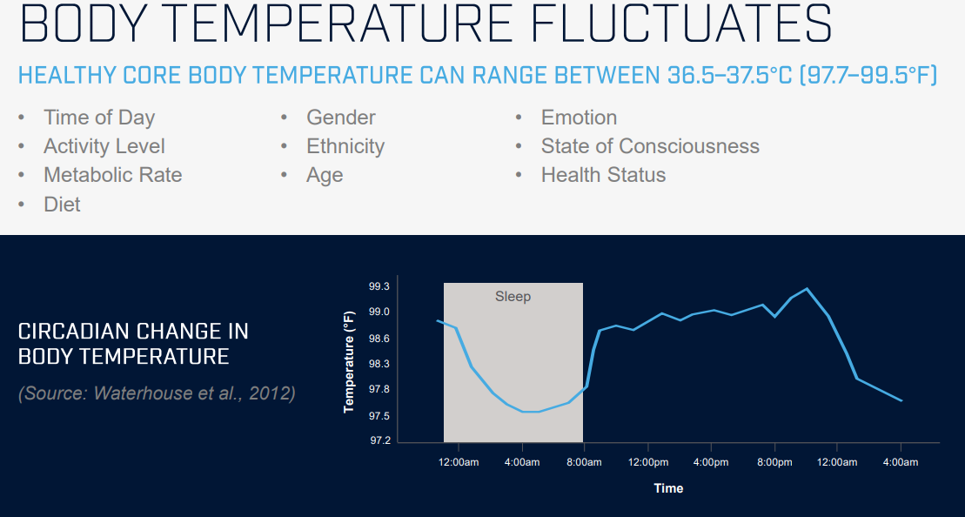

Slide 5
Key Takeaways:
2 Types – Portable Handheld and Fixed Mount
Accuracy or Throughput – It’s Challenging To Have Both
Best Correlation to Body Temperature is the Inner Corner of the Eye
Skin Temperature Will Vary Person-To-Person Based on Several Factors:
Time of Day
Placement of Camera – Indoors/Outdoors
Outside Environment – Rain, Humidity, Wind, Ambient Temperature
Not A Medical Device – Secondary Screening Still Necessary

Slide 6
INFECTION
Following COVID-19, from festival first weekend in March (Florida) to current day NYC
Symptomatic versus Asymptomatic
Incubation period: Length in time between exposure to an infection and the appearance of the first signs and symptoms. CDC states that COVID-19 symptoms may appear as soon as two days or as long as fourteen days after first exposure
Spreading coronavirus: People are most likely to spread COVID-19 when they’re really sick and showing symptoms, like fever and cough. But it is possible for people with COVID-19 to spread it when they have no symptoms and don’t even know they are sick

Slide 7
Temperature screening
Assessment
SAFE(er): 72 hours with no signs and symptoms, fever reduction without medication, get negative test, wait 24 hours and get tested negative again.
Normal temperature: 98.6°F ( 37°C )
Low-grade fever: 100.4°F ( 38°C )
The difference between core (Tc) and surface temperature (Tsk): Temperature taken on the forehead is usually 0.5°F (0.3°C) - 1°F (0.6°C) lower than an oral temperature

Slide 8
Temperature Screening
Assessment
Black body radiation technology is electromagnetic radiation given off by solid matter when at a certain temperature. It is this form of radiation that allows for the visible detection of the temperature coming from any mass, which in turn allows thermography to generate an image that is different.
SPO2: Oxygen levels as a diagnostic tool Y/N

Slide 9
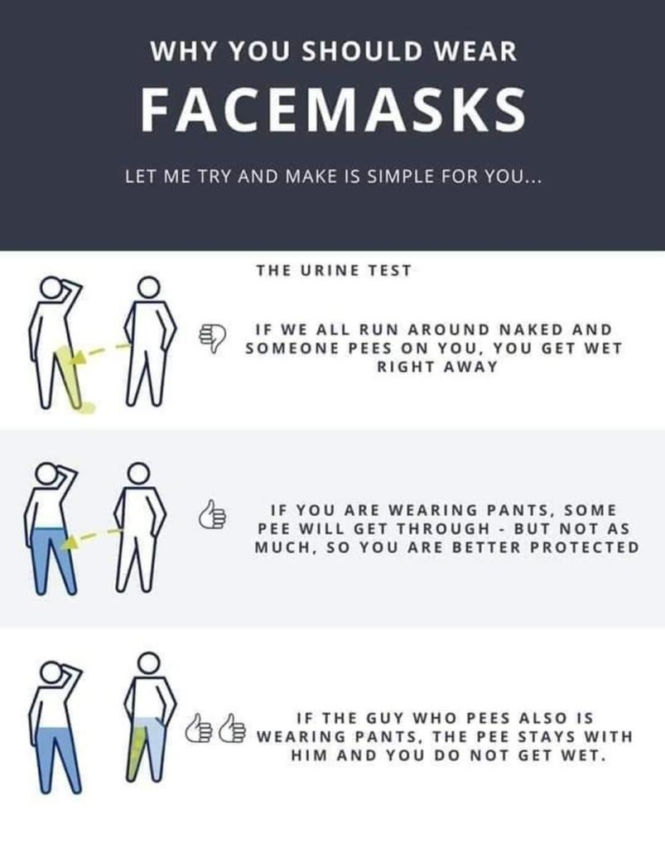

Slide 10
Testing and vaccination
What you need to know
There is currently no vaccine for COVID-19
Currently coronavirus tests are not easily accessible to the public.
Antibody tests (unless administered by a reputable lab) aren’t super accurate and there are a lot of false negatives.

Slide 11
Questions?

Slide 12
Sanitization Processes
Overall Sanitization Plans
Must include more than just temp checks
Must start at the top of the organization to instill the right culture
Can be labor intensive process
Mask and glove considerations
Must do what you say you will do

Slide 13
Technology considerations
Thermal Camera Solutions
Basic thermal technology solutions
Advanced technology solutions
Things to consider when deploying technology

Slide 14
Privacy Issues
Federal, State and Local Laws May Apply
Must consider what happens when guest has high temp at screening
What do you do if a guest refuses to wear a mask? How do you enforce it?
Can be labor intensive process
Considerations for contact tracing, exposed equipment or locations in a venue
Guidelines from CDC or local health department

Slide 15
Other Considerations
On our path to vaccinations
Put simply: the laws are complicated.
We need to account for the cascading effect of laws from Federal to state to local governments.
For example, Mayor of Los Angeles has instituted stricter guidelines than the Governor of California, who has dictated stricter guidelines than the White House.
Plan to reopen commercial office buildings, stadiums, arenas, etc. should be multi-faceted to include:
Big Data
Contact Tracing
Rapid Testing

Slide 16
Questions?

Slide 17
Daniel Ward
Email: Daniel.l.ward@usm.edu

