Slide 2
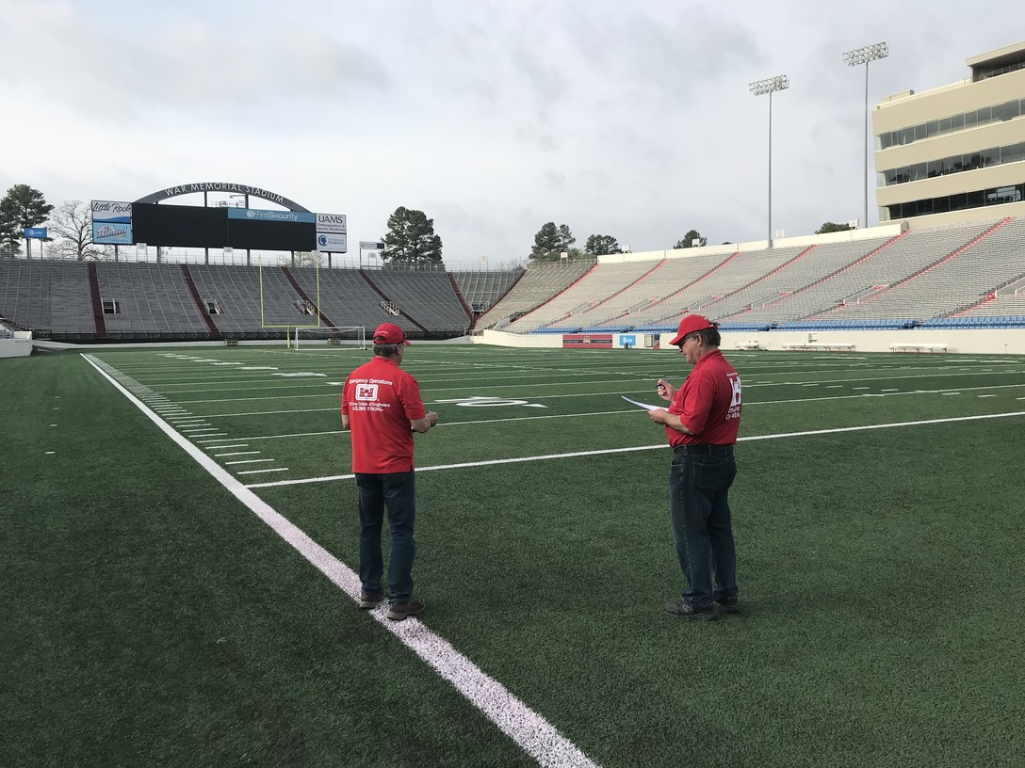
Site visit expectations
What to expect when meeting with gov’t officials
Facility Inspection
Secure Perimeter
General Safety Inspection
Logistical Considerations
Power Supply
Temporary shelters
Traffic flow
Site Walk Through
Meet & greet with the facility lead engineer
Key systems and emergency procedures
The U.S. Army Corps of Engineers evaluates War Memorial Stadium in Little Rock, Arkansas, as a possible alternate care site. (Source: USACE; Photo: Jay Townsend)

Slide 3
Planning considerations
Plan now to support your community tomorrow
Start the internal planning process as soon as practical – engage more than just the venue senior leadership and operations team and consider the following:
What capabilities can we offer?
Logistics, support services, commodities…?
What is our overall risk tolerance?
What insurance and liability coverages need to be in place?
What scheduling considerations do we need to consider?
Should events be cancelled or postponed?
Should we consider establishing an internal planning task force?

Slide 4
Engagement strategy
Have a list of questions ready to ask during the meeting
What involvement do you need from our staff or vendors?
How will staff be protected?
What are the potential liabilities and who will assumes them?
What costs are being covered and how?
What legal documentation is needed?
How long is the operation expected to last?
How will incidental damages, breakdown, and cleanup be handled?

Slide 5
Management Considerations
Joining Me on Todays Webinar are
Gilbert Marroquin – Manager Security Programs and Systems
Raphael Antonio – Associate Safety Systems Specialist

Slide 6
Managing the “event”
Create a daily/weekly/monthly checklist for the “event”
Handle the emergency operations as you would handle an event, however with COVID-19 modifications. Remember, no challenge is the same:
Cleaning/Housekeeping
Packages/Deliveries
Electrical/Utility Services
Emergency Response
Restrooms
First Aid/EMT Staffing
Floor Plans/Floor Weight Load
Food & Beverage
Freight Elevators
Audio/Visual
Lighting
HVAC
Internet Services
Industrial Liquids & Chemicals
Loading Dock Access
Venue Access
Security
Media/Social Media
Parking
Permits/Licenses
Recycling
Rigging
Set-up
Telecommunications
Information Desk
Signage
Notes:
Lessons learned:
Cleaning
Trash
Deliveries
Security
Communication
Venue staffing needs such as engineers? Electricians? Building Security?

Slide 7
Managing the venue
Put in place Venue Emergency Action Plans (EAP), Continuity of Operation plans (COOP), and follow Local City/County/State guidelines.
How do we keep our essential workforce safe?
How do we maintain the overall facility?
How do you keep your workforce informed?
How do you prepare your venue when the emergency response operations are lifted?
Notes:
How do we keep our essential workforce safe?
Cleaning, PPE, Training
How do we maintain the overall facility?
Non-contracted spaces, cleaning, any alterations and improvements you had pending
How do you keep your workforce informed?
Create a taskforce to pushout latest and greatest information
How do you prepare your venue when the emergency response operations are lifted?
Ensure contractual obligations where met, pushout out information to upcoming events: there is no immediate impact to their events/

Slide 8
Options for consideration
“None of us is as smart as all of us”
Prepare your venue for the new normal
Invest in technology
Training/Education of the workforce
Essential vs Non-Essential employees
Review your plans/programs
Notes:
Technology: not just security related but overall: POS, Queueing, Ticketing, Security
CLOSE WITH PHYSICAL DISTANCING!~~~~~

Slide 9
Questions?

Slide 10
When to return to normal ops
Key to successful recovery is to start planning early
Basic triggers for consideration:
Status of critical infrastructure in the area
Status of the health care system
Status of schools/daycare centers
Scientific and regulatory indicators
Status of the supply chain
Local ordnances
Travel

Slide 11
How to return to normal ops
Once triggers are enacted and state and local restrictions are lifted – then the process of returning to normal ops begins

Slide 12
Personnel
Leaders must address staff concerns returning to work
How has extended telework impacted morale and staff well-being?
Are staff willing to return to the office/stadium/venue?
What mechanisms are in place to address burnout, fatigue, stress?
Are policies in place to address privacy?
Will your organization restrict travel?
Are leaders prepared to remind staff to stay home if feeling sick?
Footer

Slide 13
Physical Infrastructure
Safe conditions are paramount to successful transition
Has the facility been cleaned, consistent with CDC and EPA guidelines?
Is your IT Infrastructure adequate and safe?
Will you in maintain social distancing – if so for how long?
Should staff work in shifts – how will you divide the staff/operations?
Will you limit external visitors?
Do you have adequate anti-microbial cleaning and sanitizing supplies?
Footer

Slide 14
Permanent changes to ops
Now is the time to explore changes to business ops
Conduct an after-action review
Re-evaluate business continuity plans
Assess your supply chain
What will the “new normal” look like?
What travel considerations need to be addressed, at least for the foreseeable future (i.e., foreign travel)?
Footer

Slide 15
Prepare for the next wave
Better to be prepare now rather than risk the alternative
Evaluate your current response posture
Determine what plans, policies, and procedures need to be updated (including insurance plans)
Include training and exercises to test and validate any updates
Account for other disasters or issues (e.g., cyber-attack, other natural disaster)
Examine IT infrastructure
Revisit what role, if any, your venue will play?
Footer

Slide 16
Questions?

